Slide 1
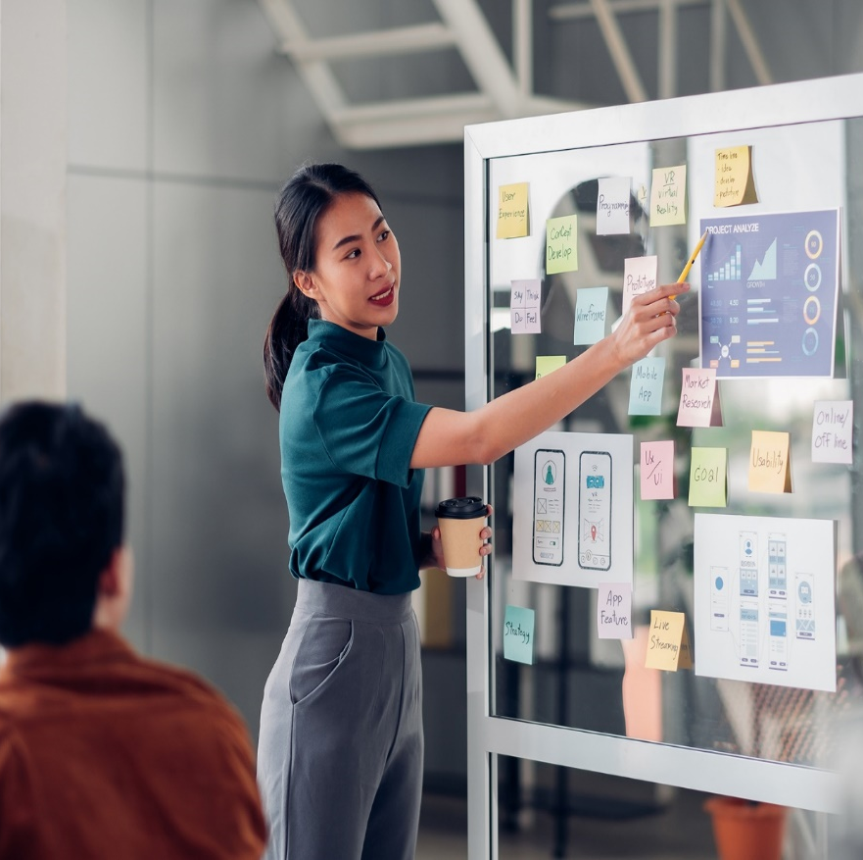
CivicPlus-UST Product Engineering
Team Ironman - Offshore team for Civic
Engage Central.
Team Sentinels- Offshore team handles
automation and releases for multiple products.

Slide 2
Current Week
Associate Name | Duration (Days) | Dates
Kritika Raghuwanshi | 5 | 18th to 22nd May.
Ishwar Devhare | 1 | 21st May.
Vitthal Wankhede | 1 | 18th May.

Slide 3
Leaves Planned
Associate Name | Duration (Days) | Dates
Saurabh Sawant | 3 | 15th to 17th June.

Slide 4
Open Action
Risk / Issue
Team | Risk/Issue | Details | Owner | Status
Iron Man | Production data access​ | All Developers has access to production data. We recommend to restrict the access to production data to key developers and provide the need basis access to production to avoid any data security issues. | Civic Plus | Open

Slide 5
UST Holiday Calendar - 2026
No
1
2
3
4
5
6
7
8
Sr. No. | Company Holiday | Date(dd-mm-yyyy) | Day
1 | Republic Day | 26th Jan 2026 | Monday
2 | Holi | 3rd Mar 2026 | Tuesday (Pune location only)
3 | Ugadi | 19th Mar 2026 | Thursday (Bangalore location only)
4 | Idul Fitr/Gudi Padwa | 20th Mar 2026 | Friday
5 | Maharashtra Day | 1st May 2026 | Friday
6 | Ganesh Chaturthi | 14th Sept 2026 | Monday
7 | Gandhi Jayanti | 2nd Oct 2026 | Friday
8 | Dussehra(Mahanavami) | 20th Oct 2026 | Tuesday
9 | Christmas | 25th Dec 2026 | Friday

Slide 6
UST Product Engineering

